Slide 1
Capstone Engagement
Assessment, Analysis, and Hardening of a Vulnerable System

Slide 2
Table of Contents
This document contains the following sections:
01
Network Topology
02
Red Team: Security Assessment
03
Blue Team: Log Analysis and Attack Characterization
Hardening: Proposed Alarms and Mitigation Strategies
04

Slide 3
Network Topology
‹#›

Slide 4
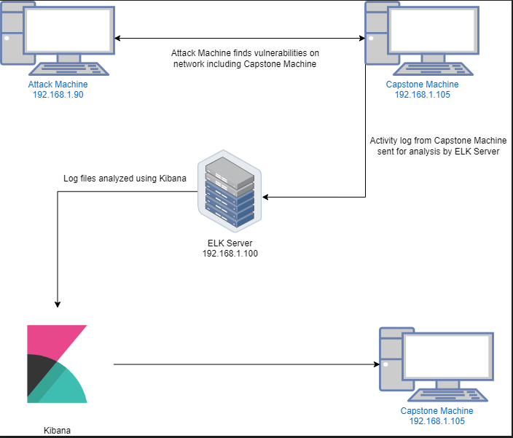
Network Topology
Network
Address Range: 192.168.1.0/24
Netmask: 255.255.255.0
Gateway: 10.0.0.76
Machines
IPv4: 192.168.1.1
OS: Windows 10
Hostname: Azure Hyper-V-ML-RefVm-684427
IPv4: 192.168.1.90
OS: Kali GNU/Linux
Hostname: Kali
IPv4: 192.168.1.100
OS: Ubuntu
Hostname: ELK
IPv4:192.168.1.105
OS: Ubuntu
Hostname: Capstone

Slide 5

Red Team
Security Assessment
‹#›

Slide 6
Recon: Describing the Target
Nmap identified the following hosts on the network:
Hostname | IP Address | Role on Network
Hyper-V Azure machine ML-RefVm-684427 | 192.168.1.1 | Host Machine Cloud Based
Kali | 192.168.1.90 | Attacking Machine
Elk Stack | 192.168.1.100 | Network Monitoring Machine running Kibana
Capstone | 192.168.1.105 | Target Machine that Replicates a vulnerable server

Slide 7
Vulnerability Assessment
The assessment uncovered the following critical vulnerabilities in the target:
Vulnerability | Description | Impact
Open port with public access CVE-2019-6579 (Port 80) | Unsecured access to anyone attempting entry using Port 80. | Sensitive (and secret) files and folders can be found.
WebDAV Vulnerability | Exploit WebDAV on a server and shell access is possible | A WebDAV that is not configured properly can allow hackers to remotely modify website contents.
Hashed Passwords | A password that is not salted can be easily cracked via online tools such as www.crackstation.com or programs such as hashcat. | A hacker can easily access system files if a username is already known and once they crack a password.
Root accessibility | Authorization to execute commands and access any resources on the vulnerable | Vulnerabilities can be leveraged. Extensive potential impact on any connected network.

Slide 8
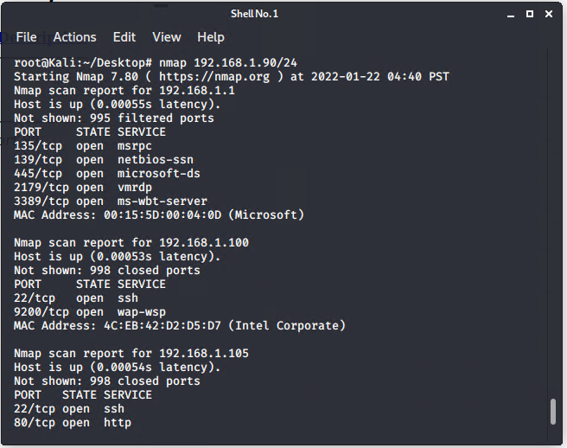
Exploitation: [Port 80 Open to Public Access]
01
03
Tools & Processes
I used nmap to scan for open ports on the target machine
02
Achievements
Nmap scanned 256 IP addresses and found 4 hosts and the 2 open ports that peaked my interest was port 22 and port 80

Slide 9
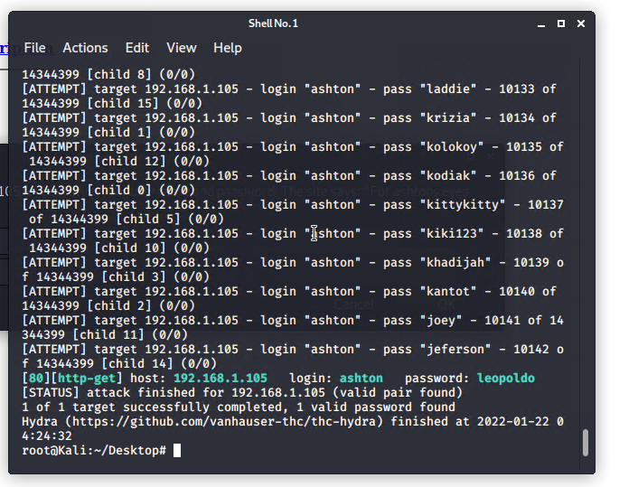
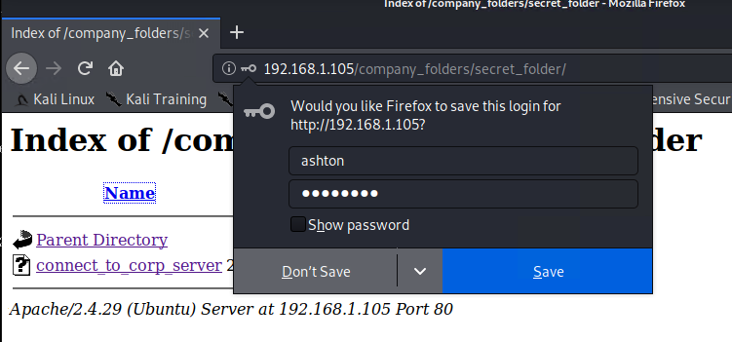
Exploitation: [Brute Force Password]
01
02
03
Tools & Processes
I used Hydra which is preinstalled on Kali Linux. I also used rockyou.txt as it also required a password list.
Achievements
This exploit confirmed the username “ashton” with the password “leopoldo”
[INSERT: screenshot or command output illustrating the exploit.]

Slide 10
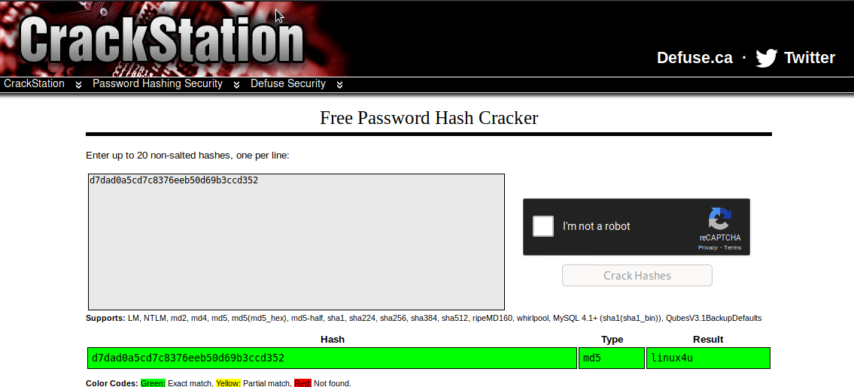
Exploitation: [Hashed Password]
01
02
Tools & Processes
I used crackstation.com to crack the hashed password
Achievements
Used the username “Ryan” to access the /webdav folder with the password “linux4u”
03

Slide 11

Blue Team
Log Analysis and Attack Characterization
‹#›

Slide 12

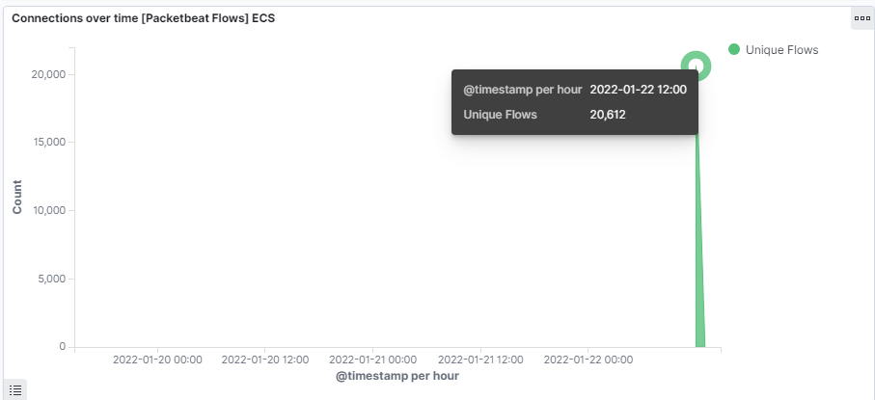
Analysis: Identifying the Port Scan
The port scan started on 22nd of January 2022.
20,612 connections occurred a the peak, the source IP was 192.168.1.90
The sudden peaks in network traffic indicate that this was a port scan.

Slide 13
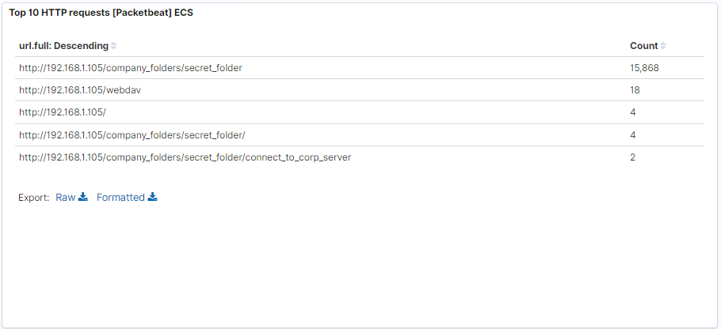
Analysis: Finding the Request for the Hidden Directory
The request started on the 22nd of January 2022.
There were 15,868 requests made to access the /secret_folder.
The /secret_folder contained a hash that could be used to access the system using another Ryan’s credentials
The secret folder also allowed me to upload a payload which can be used to exploit other vulnerabilities.

Slide 14
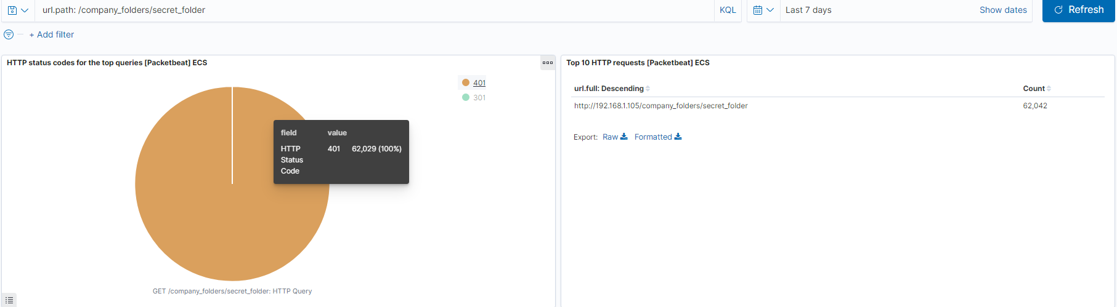
Analysis: Uncovering the Brute Force Attack
62,042 requests were made during the attack to access the secret folder.
62,029 requests were made before the attacker discovered the password.

Slide 15
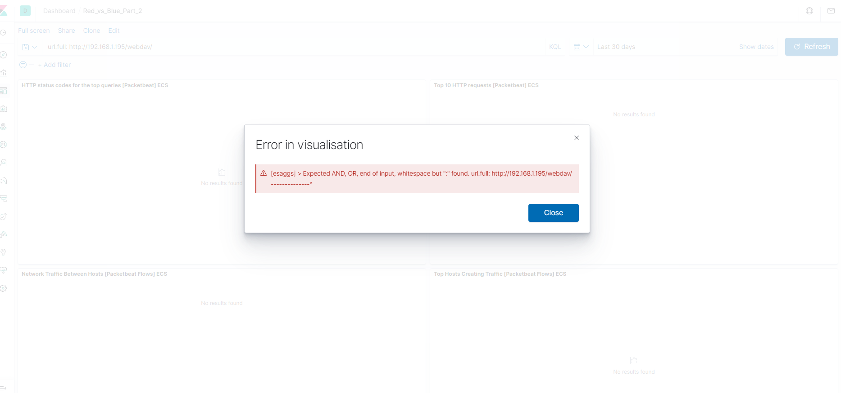
Analysis: Finding the WebDAV Connection
Getting an error when querying url.full: http://192.168.1.105/webdav
Getting blank results when querying url.full: “http://192.168.1.105/webdav”

Slide 16
Blue Team
Proposed Alarms and Mitigation Strategies
‹#›

Slide 17
Mitigation: Blocking the Port Scan
Set pings every time there are 1000 connections within an hour.
Make sure the firewall is always updated to minimize new zero-day attacks
The firewall should be able to cut off the scan attempts in real time.
Set server iptables to drop packet traffic when thresholds are exceeded
Run a system port scan regularly to detect and record any open ports.

Slide 18
Mitigation: Finding the Request for the Hidden Directory
I will set an alert when there are requests to for the secret folders and files to detect any unauthorized access.
I would recommend a threshold of maximum 5 attempts per hour that would trigger an alert to be sent.
Any highly confidential folders should not be shared for public access.
Make sure data contained within confidential folders are encrypted.
Review IP addresses that cause an alert to be sent: either whitelist or block the IP addresses.
Do not use any obvious naming conventions for sensitive/company critical data/private folders

Slide 19
Mitigation: Preventing Brute Force Attacks
A HTTP 401 Unauthorised client error indicates that the requests has not been applied because it lacks valid authentication credentials for the target source.
By setting an alarm that alerts if a 401 error is returned we can detect any future brute force attacks.
I would set a threshold of 5-10 errors returned to activate this alarm.
Create a policy that locks out accounts for 30 minutes after 5 unsuccessful attempts
Create a policy that requires password complexity. This passwords will be compared to common password lists and prevent users from reusing historical passwords.

Slide 20
Mitigation: Detecting the WebDAV Connection
Create a whitelist of trusted IP addresses and review this list every 6 months.
I would set an alarm on the HTTP GET request that activates on any IP addresses trying to access the webDAV directory outside of those trusted IP addresses.
When any HTTP PUT request are made this will activate this alarm.
Creating a whitelist of all trusted IP addresses and making sure that my firewall security policy blocks all other access.
I would also ensure that any access to the webDAV folder is only permitted to users with complex username and password.

Slide 21
Mitigation: Identifying Reverse Shell Uploads
Alerts will need to be set for any traffic attempting to access port 4444.
I will set the threshold for this alert to activate whenever one or more attempts are made.
Make sure that only the necessary ports are open.
Block any IP address other than the whitelisted IP addresses as reverse shell can be created over DNS this action will only limit the risks of reverse shell connections, not eliminate the risk.
Set the access to the /webDAV folder to read only to prevent payloads from being uploaded.

